Slide 1
RNA Seq
Best Practices, Best Tools
Notes:
Ok. So in this section Im going to talk about RNA seq – high throughput sequencing from RNA, not DNA and look at some of the tools we have to do that

Slide 2
Structure
AIM:
Help you develop a strategy for performing RNAseq and assembly and assessing analysis quality
Theory
Sequence Types
Algorithm Basics/ Tool Types
Assessing an Alignment/Assembly
Tools
For Alignment/Assembly
For Differential Expression
Notes:
The aim with this section will be to give you a bit of background and help you to come up with a first strategy for doing genome assembly
To start I’ll go over a bit of theory on the sequence types and have a look briefly at the basics of the techniques that we use
Then we’ll look at the tools for actually doing the alignments and assembly and working out differential expression.

Slide 3
Why RNA Seq?
Gene expression and differential expression
Alternative expression analysis
Transcript discovery and annotation
Allele specific expression
Relating to SNPs or mutations
Mutation discovery
Fusion detection
RNA editing
Notes:
Ok, So RNA seq is the most flexible approach I’ll talk about today, it has many uses. The main difference between this and genome seq or DNA seq is that this is potentially quantitative.
You can use it for gene expression and differential analysis, including alternative splicing detection and isoform expression. You can use it for SNP/Indel and allele specific expression patterns and for gene fusing and RNA editing.

Slide 4
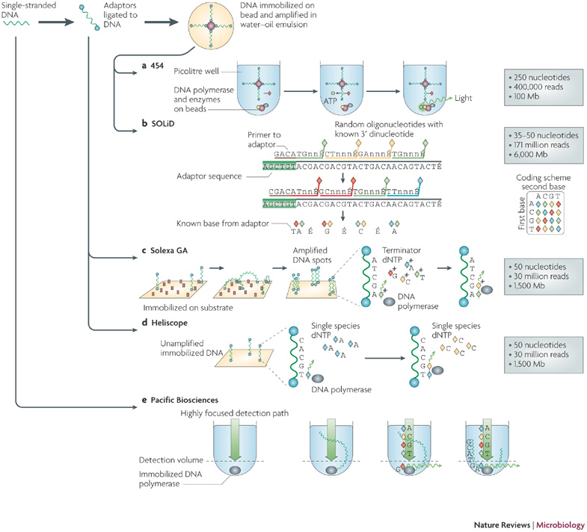
Sequencing
Two major kinds
- Illumina
- Pacific BioSciences
Illumina
Sequence by Synthesis
PacBio
Single Molecule Real Time
Notes:
For all these things there are two main technologies that that get used. The first is Illumina sequencing by synthesis, this is the older technology and it works basically by using small primers bound to a slide that bind to the ends of DNA fragments that you wash over them. Then these fragments are amplified by PCR to make large clusters of the same sequence. To actually sequence you introduce terminator fluorescent dNTPs in cycles and measure the fluorescence that comes from each spot in each cycle, so you sequence by synthesising a complementary strand.
The other technology is Pacific BioSciences Single molecule system which is based on a slide with tiny zeptoliter holes in it and DNA polymerase tethered to the bottom. When DNA is introduced the polymerase startes to synthesise and incorporates the fluorephores which are recorded as it goes, to get high accuracy each molecule has to be read multiple times

Slide 5
Paired-end Reads
Paired End
Read both ends of the molecule
Separated by ~ 500 bp
Notes:
The are different ways of preparing the RNA for sequencing that results in some extra information about reads. With Paired end and mate paired strategies then you get info about the distance between the reads. In Paired end you basically read both ends of a molecule that you more or less know the length of, these tend to be separated by about 500 bp in practice, this has advantages in alignment and assembly later

Slide 6
Brief sequence comparison
 | Illumina | PacBio
Length | <300bp | <10kb
Reads per run | 25 – 400 million | ~50 thousand
accuracy | >99% | ~86%
Notes:
So there are some more practical differences, Illumina reads are much shorter, though that headline figure from PacBio is more like 5kb in practice. And as you can see the PacBio length gets you very close to the length of whole transcripts.
You do get many more reads from Illumina and much higher accuracy, but it isn’t cut and dried as to which you should use for every application, the decision will be very case dependent. These are the basic facts you should know though

Slide 7
The RNAseq Pipeline
RNA-seq reads (2 x 100 bp)
Read alignment
Transcript
Compilation
Gene
Identification
Expression Estimates
Raw sequence data
(.fastq files)
Reference genome
(.fa file)
Gene annotation
(.gtf file)
Visualisation
Inputs
Notes:
Ok, so this is a typical RNAseq workflow. The key things to note here are that its an involved workflow that often needs more initial info than in genome assembly/
You’d start off with your sequence, usually paired end reads and then once that is QC’d and you’re happy with the quality you can go on to do an alignment of the reads to a reference genome, this of course requires you have a genome sequence to align to. It is possible to do completely de novo transcript assembly if you don’t have that.
Then there’s compilation and assembly of the alignments or assembly into actual transcript models and annotation of those models.
And once you know what transcripts you can start to quantify

Slide 8
Alignment with Millions of Sequences
Computational cost
100’s of millions of reads
Oldstyle (Smith-Waterman) – Newstyle (Burrows Wheeler Transform, Suffix Trees)
Introns!
Spliced vs. unspliced alignments
Can I just align my data once using one approach and be done with it?
Unfortunately probably not
Notes:
So the crucial step is alignment to the reference. This is done with custom high throughput tools. We can’t do old-style blast alignments with 100s of millions of reads because of the large computational cost - those older algorithms don’t scale well up to data that size,
Newer programs based on structures called Burrows Wheeler Transfomr scale linearly so can handle this.
A significant issue is how to deal with introns, RNA doesn’t have them in the sequence so the read has to be split appropriately.
And as with all bioinformatics, there isn’t a magic button or solution that gives the right answer every time so you are going to be QC ing and comparing approaches throughout the process.

Slide 9
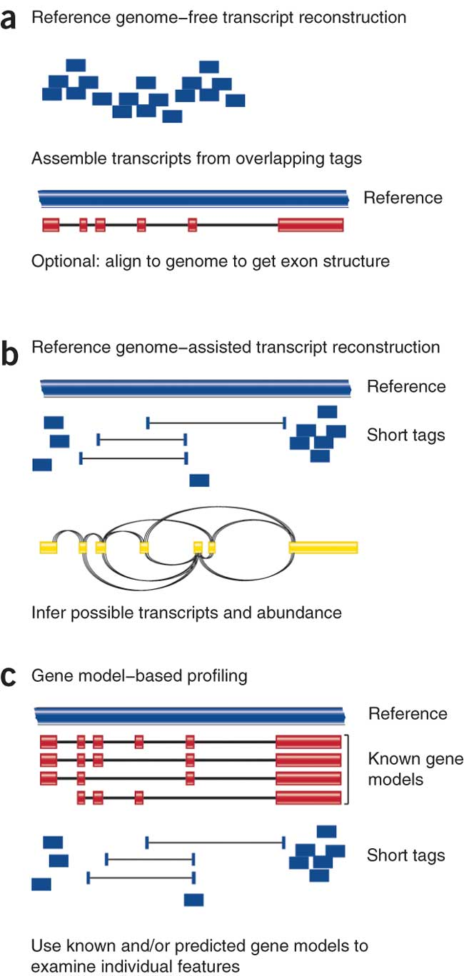
Alignment (mapping) strategies
De novo assembly
Align to transcriptome
Align to reference genome
Diagrams from Cloonan & Grimmond, Nature Methods 2010
Notes:
Which alignment and assembly strategy to take will depend on the application.
You’ll be best served with De novo assembly
If a reference genome does not exist for the species being studied
or If complex polymorphisms/mutations/haplotypes might be missed by comparing to the reference genome
Aligning to a transcriptome – so gene model or CDS seqeunce is best
If you have short reads (< 50bp)
Aligning to a reference genome is still generally a good idea In all other cases, but you may be advised to mix it up with a completely de novo assembly to help guard against errors in the reference genome
Each strategy involves different alignment/assembly tools

Slide 10
Alignment Tools
RNA
Bisulfite
DNA
microRNA
http://wwwdev.ebi.ac.uk/fg/hts_mappers/
Notes:
There are over a hundred next generation alignment tools, and I can’t possibly list or discuss them all. They each have specialisations for particular things and everyone has a different favourite for different reasons. The main thing is to find one that works for you and that you’ve shown creates sensible, verifiable output by a control experiment.
I will discuss some generally well used aligners though.

Slide 11
Splice Aware Aligners – Tophat/Bowtie
RNA-seq reads may span introns
Read X
Read Y
Exon 1
Exon 2
?
Read X
Map with Bowtie
Read Y
Exon 1
Reference
Exon 2
Read Y
Read X
Aligned Bin
Unaligned Bin
Notes:
So the main one I want to mention is the TopHat/Bowtie pair of tools that carry out Splice Aware alignments. Here’s how they work together.
The fragments being sequenced in RNA-seq represent mRNA and therefore the introns are removed
And as we are usually aligning these reads back to the reference genome so, unless your reads are short (<50bp) you need to be mindful of that
The first stage of alignment requires a reference genome, the program breaks reads into pieces, uses ‘bowtie’ aligner to first align these pieces. Anything that aligns well, like this blue read on the first exon is kept
Any read that has only a partial good match is sent to an unaligned bin for further consideration
Then extends alignments from these seeds and resolves exon edges (splice junctions)

Slide 12
Splice Aware Aligners - Tophat
X1
X2
X3
Read X
Read X
Unaligned Reads
X2
?
X1
X3
Exon 1
Reference
Exon 2
Collect Mapping Information for X1 and X3
Construct a Splice Library
Notes:
TopHat Then makes seed alignmets from the fragmet and unaligned information
Then it extends alignments from these seeds and resolves exon edges to construct a splice library. So the take home is that reads get cleverly split ofver potential introns to make splice variants

Slide 13
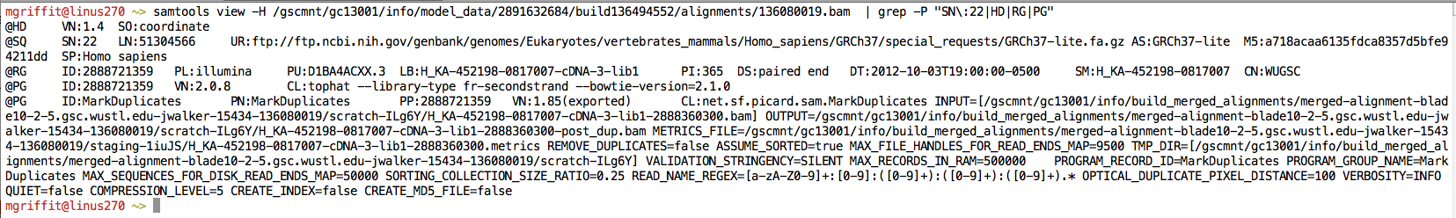
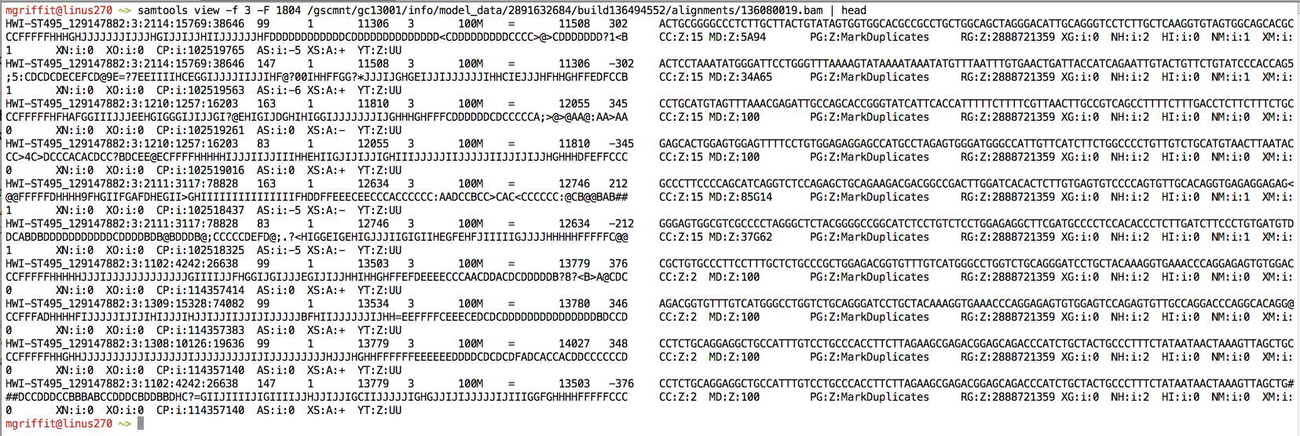
SAM/BAM
Example SAM/BAM header section (abbreviated)
Example SAM/BAM alignment section (only 10 alignments shown)
Notes:
When you’ve created an alignment, pretty much every program generates this output – this is SAM output and manipulating this is the key to working out whats going on with your alignments. You get one line for every read, so its not something you can do with from the file, rather you’ll want to visualise and summarise the alignments especially to do quality control of the alignments. The eventual transcript models you come up with are heavily dependent on the quality of the alignments, so they need to be good.

Slide 14
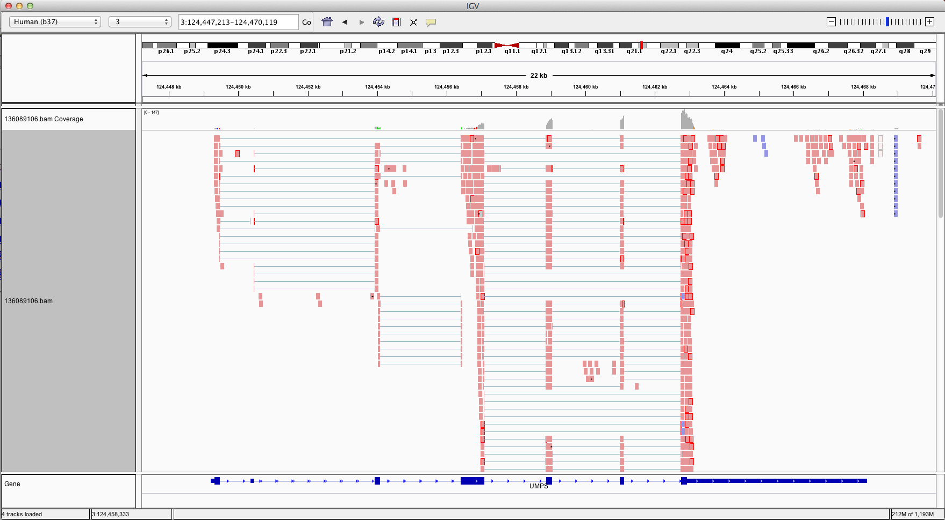
Visualizing Alignments
IGV
Ideogram
Coverage
pileup
Control pop-up info
Viewer position
Coverage
track
Coverage
scale
Single reads, not spliced
+ve
strand
-ve
strand
Reads track
Single reads, spliced
Gene track
Notes:
There are a few good genome browser tools that will help you see the alignments on the reference. The one here is IGV – integrated genomics viewer
It shows the reference as a single line atthe top of the window and the main block is the alignment from a SAM file. Each pink mark is a part of the read that is aligned and the blue thing at the bottom is the pre-existing gene model.
So you can tell how well the read model is supported by the alignment, how clear the alignment is, and generally start to get a feel for whats going on. These views are especially good when you want to inspect single candidate genes later in the analysis

Slide 15
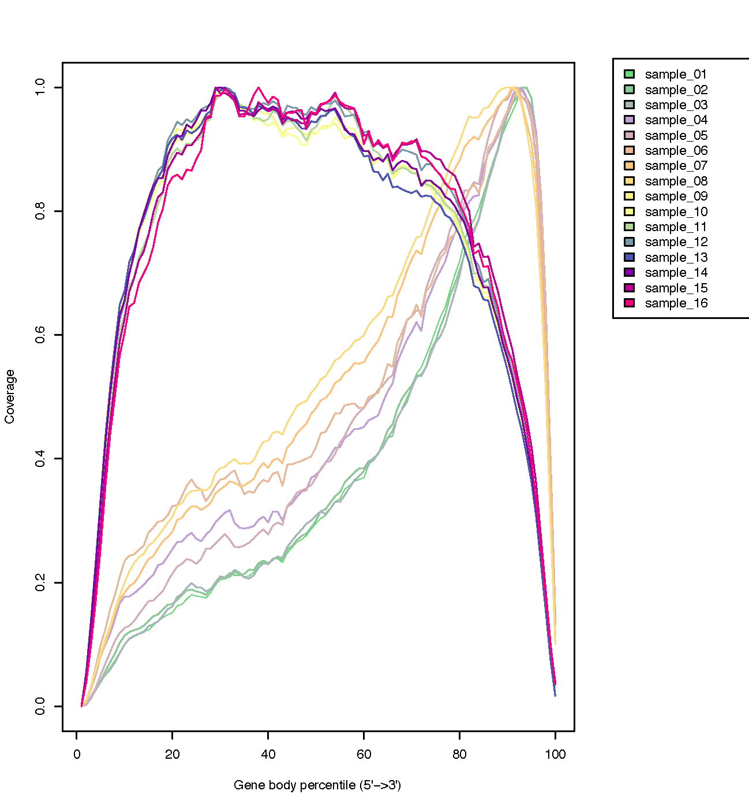
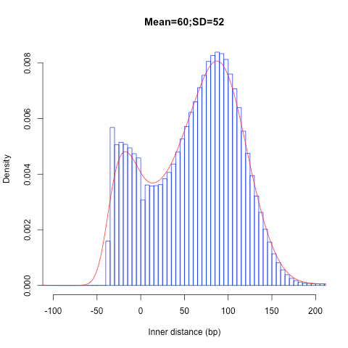
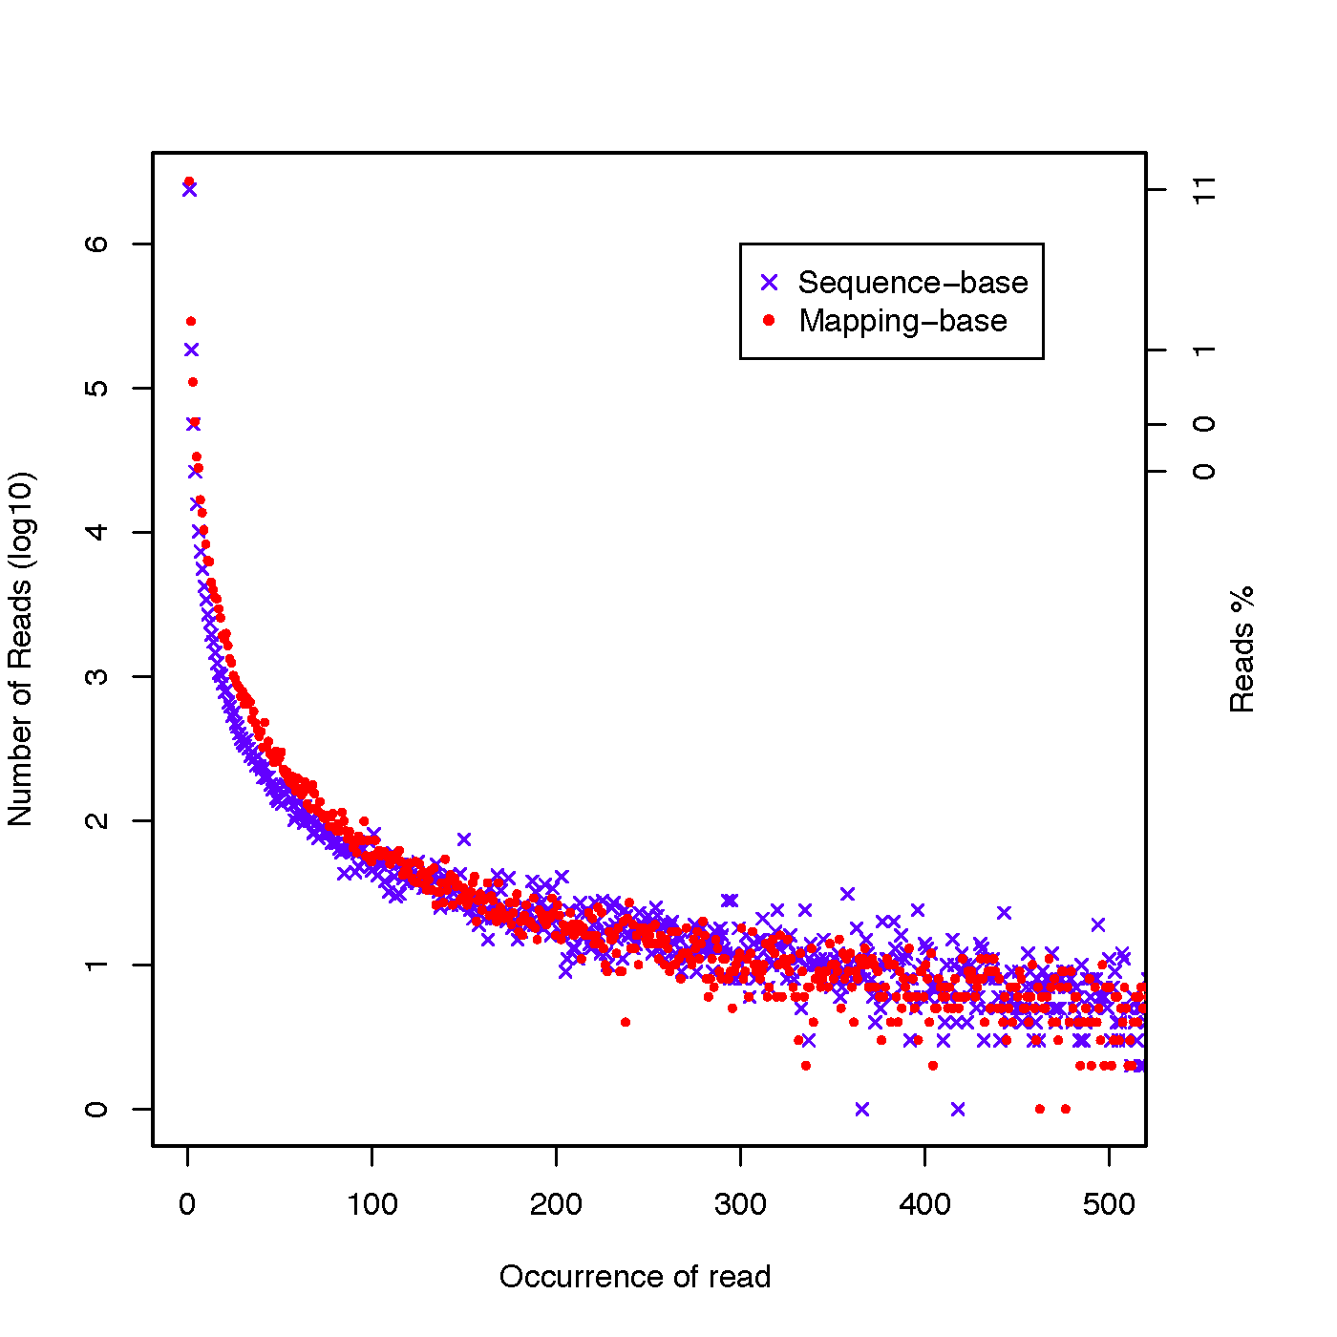
Alignment QC
Transcript coverage 3’ Bias
Insert Size
PCR Duplicates
http://rseqc.sourceforge.net
Notes:
Doing summary QC is important, you can’t check every gene manually. Things to look for in the alignment are the transcript covereage evenness. So some cloning and sequence practices end up with a three prime bias in the alignment.
In this top left picture the x-axis is basically the distance across a transcript, the y axis is the read coverage, and you can see a clear bias in some transcripts for the 3 prime end – which can interfere with quantification downstream and the quality of assembly at the 5 prime.
In the top right, you can see the distribution of the mapped distance between the pairs of the reads, this is important since a too great or too small distance after mapping indicates a bad alignment of those reads – assuming the reference genome is correct!
And the bottom picture the x-axis shows the number of times a sequence appears – that is reads with identical sequence appear. So most reads appear a few times but some appear lots and lots. Often this can be due to a sequence being really abundant because of high expression levels, but also this can be an artefact caused by PCR amplification of the same sequence, so you need to keep this in mind and inspect at least a few of the highly expressed sequences manually and be prepared to go back and make changes.
These plots and analyses all come from the same program specifically designed for assessing your alignments – a program called reqc .

Slide 16
Complete de novo – no reference
Trinity
https://github.com/trinityrnaseq
Notes:
If you really don’t have a reference sequence and want to assemble the transcripts from the reads its possible to do that. TopHat and its companion Cufflinks can do that and also Trinity is a very popular and effective system for that. Basically these programs forego the alignment and instead try to build contigs by overlapping the reads as much as they can.
Then they try to assign reads back to individual contigs and sections of the overlap graph to make a rough map of paths that can be walked through to create hypothetical transcript models.
Again, like alignment and genome assembly these models are usually considered draft assemblies and need to be QC’d for integrity

Slide 17
Assembly QC
TransRate
Notes:
And one good program for doing this is TransRate
TransRate works by identifying a set of common errors in de novo or alignment based transcriptome assembly, and this figure shows how they can be detected using read mapping data.
Family collapse occurs when members of a gene family are assembled into a single contig. This can be detected by measuring how well the nucleotides in the contig are supported by the mapped reads.
Chimerism occurs when two or more transcripts are concatenated together in a single contig during assembly. This can be detected when the expression levels of the transcripts differ, leading to a change-point in the read coverage along the contig.
Bad insertions can be detected as bases in a contig that are unsupported by the read evidence.
Incompleteness can be detected when reads or fragments align off the end of the contig.
Fragmentation is caused by low coverage and is detectable when read pairs bridge two contigs.
Local misassembly encompasses various structural errors that can occur during assembly, such as inversions,
These are detectable when both members of a read pair align to a single contig, but in a manner inconsistent with the sequencing protocol.
Redundancy occurs when a single transcript is represented by multiple overlapping contigs.
TransRate takes as input one or more de novo transcriptome assemblies and the paired-end reads used to generate them. (2) The reads are aligned to the contigs. And then four different score components are calculated that assess the potential problem areas.
The four score sare integrated to generate an overall score for assembly.
So TransRate is a useful way of seeing quite quickly which bits of your assemblies need to be improved and allows you to compare assemblies from different programs or settings

Slide 18
Alignments Mappings to expression
Normalize counts for expression levels –
to account for differences in gene length, read counts are converted to Reads per kilobase of transcript mapped (RPKM)
Raw count
RPKM
8
1
24
6
8
12
RPKM_{geneA} = 10⁹ C_{geneA} / NL
C_{geneA} = number of reads mapped to geneA
N = total number of reads
L = length of transcript in units of Kb
Cufflinks/CuffDiff
Trinity
Notes:
Once you’ve got the transcripts and you’re happy with them then often you will want to go on to quantify. Its quite unsual to just take the absolute number of reads
Expression is biased for gene length (longer transcripts should have more reads) to normalize, reads are converted to Reads per Kilobase of transcript per million reads mapped
Which can completely overturn the counts but gives overall a more believable number for the whole transcript set.
Several software tools available to do mapping and calculate normalized expression measurements across different samples including Most RNAseq programs like Tophat and Cufflinks and trinity will do this and statistics modules like the Bioconductor packages DESeq, and EDGER can help with calculating these values
It can often be a choice so use?
RPKM
When you want to leverage benefits of tuxedo suite
Good for visualization (e.g., heatmaps)
Calculating fold changes, etc.
Counts
More robust statistical methods for differential expression
Accommodates more sophisticated experimental designs with appropriate statistical tests
Transcript-level plots showing transcript structures and expression levels

Slide 19
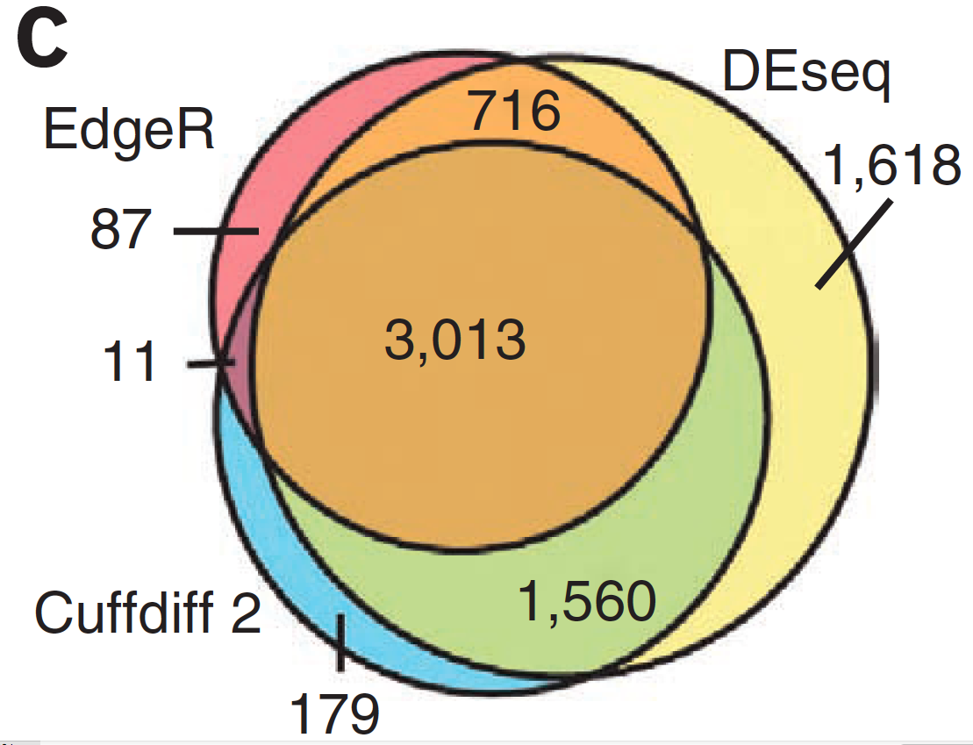
Alternative differential expression methods
Raw count approaches
DESeq - http://www-huber.embl.de/users/anders/DESeq/
edgeR - http://www.bioconductor.org/packages/release/bioc/html/edgeR.html
Notes:
Whenever you do generate differential expression methods, then you may want to try a couple of methods at least,
as they aren’t all equally sensitive or specific. So this figure shows the overlaps between differential expression calls from various methods and there are clearly some genes that only one or two methods picks up and that might be important to your study

Slide 20
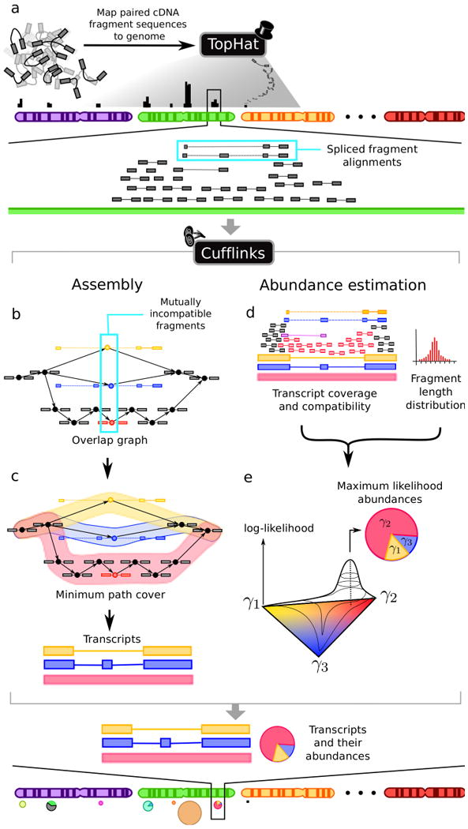
Cufflinks
Notes:
Overlapping 'bundles' of fragment alignments are assembled, fragments are connected in an overlap graph, transcript isoforms are inferred from the minimum paths required to cover the graph
Abundance of each isoform is estimated with a maximum likelihood probabilistic model
makes use of information such as fragment length distribution

Slide 21
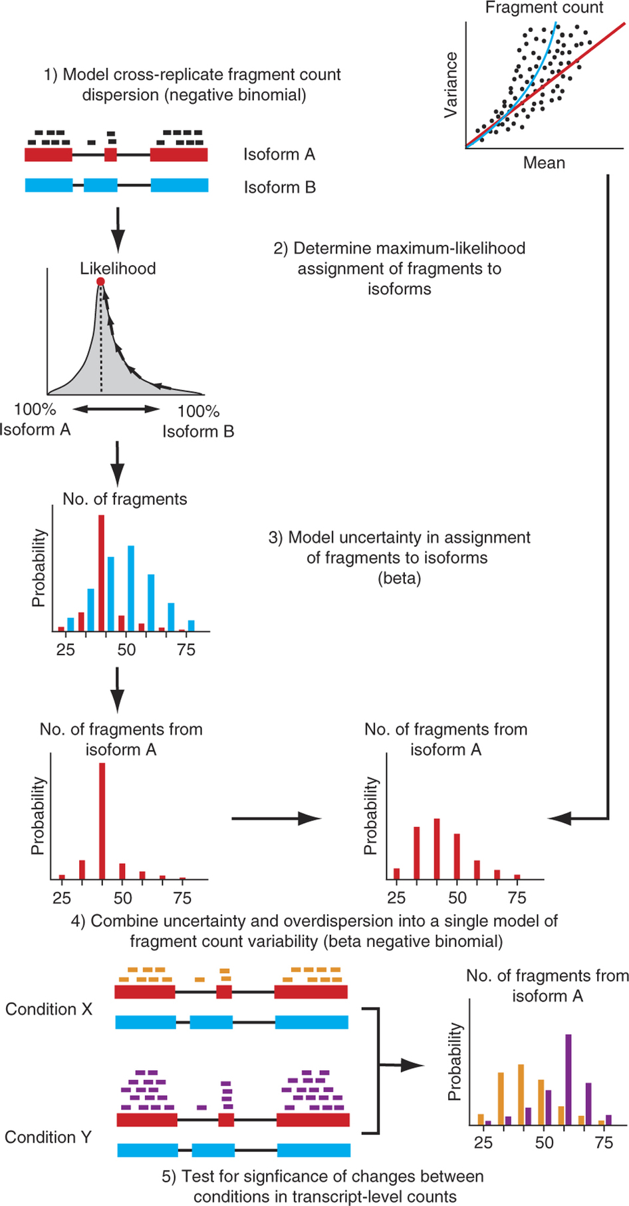
Cuffdiff
Finding differentially abundant transcripts
Notes:
The variability in fragment count for each gene across replicates is modeled.
The fragment count for each isoform is estimated in each replicate (as before), along with a measure of uncertainty in this estimate arising from ambiguously mapped reads
transcripts with more shared exons and few uniquely assigned fragments will have greater uncertainty
The algorithm combines estimates of uncertainty and cross-replicate variability under a beta negative binomial model of fragment count variability to estimate count variances for each transcript in each library
These variance estimates are used during statistical testing to report significantly differentially expressed genes and transcripts.

Slide 22
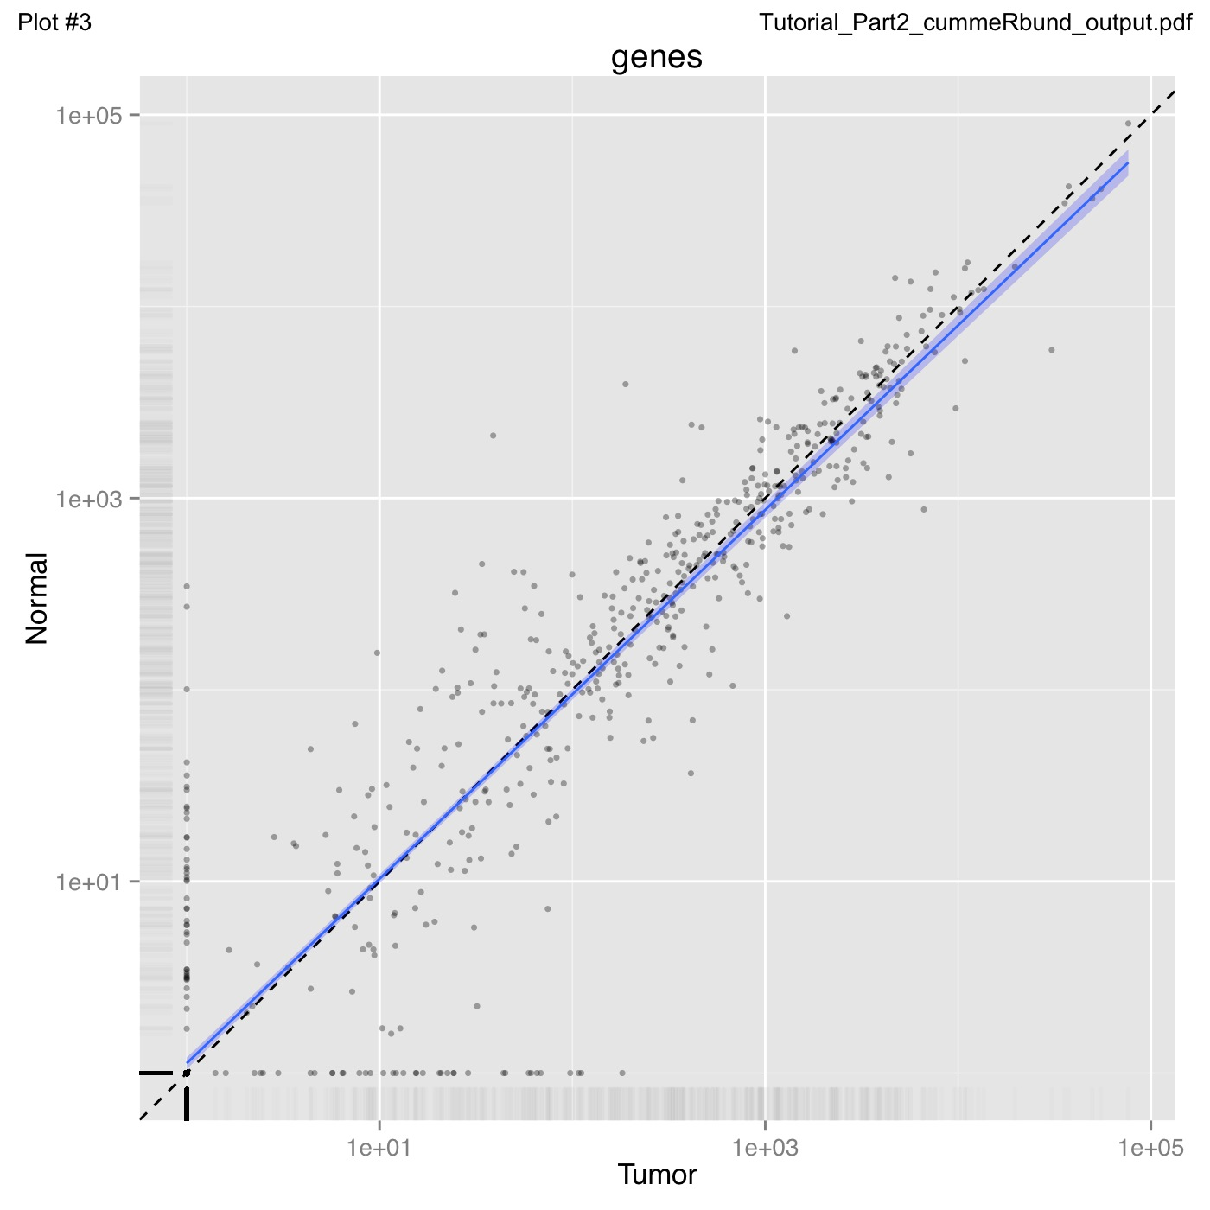
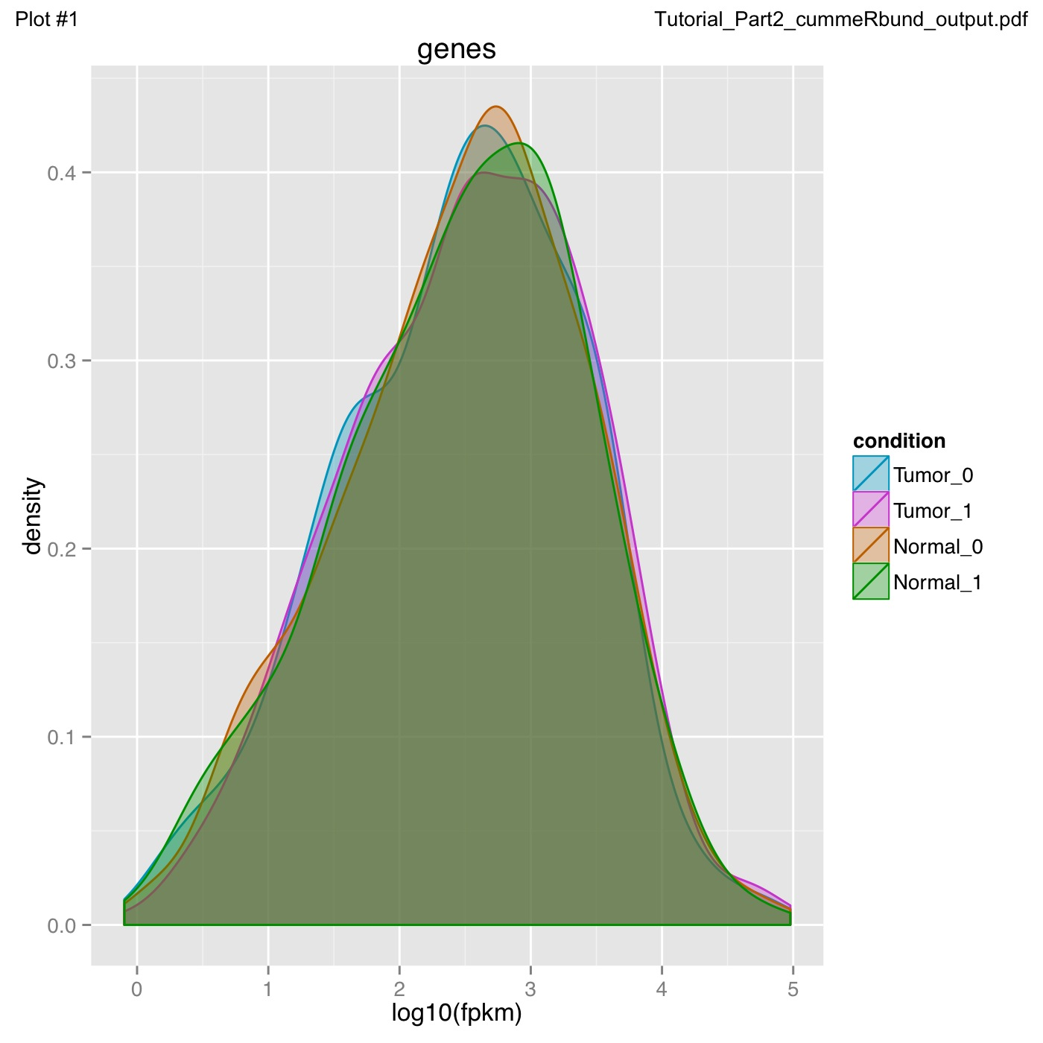
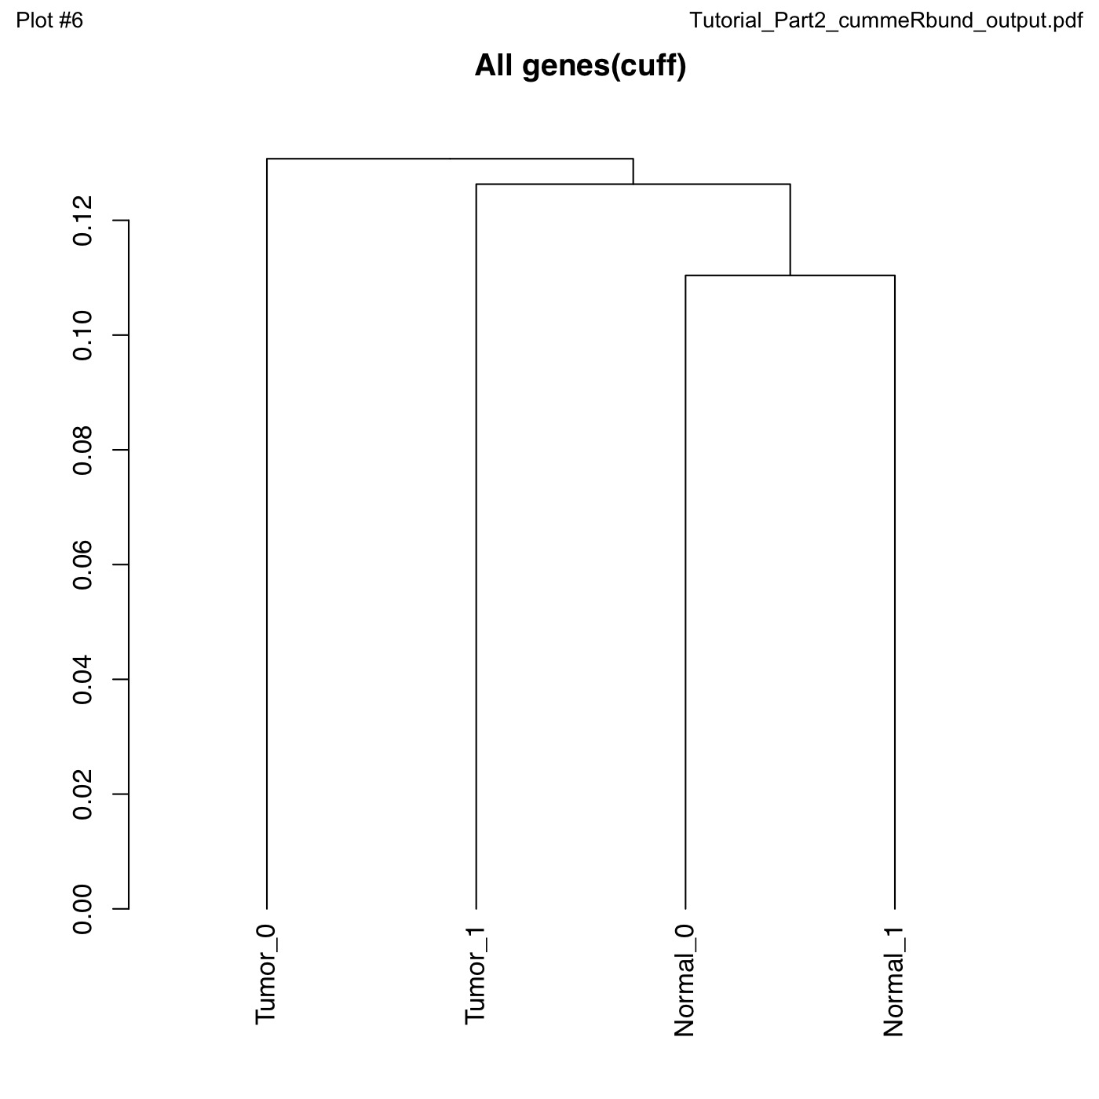
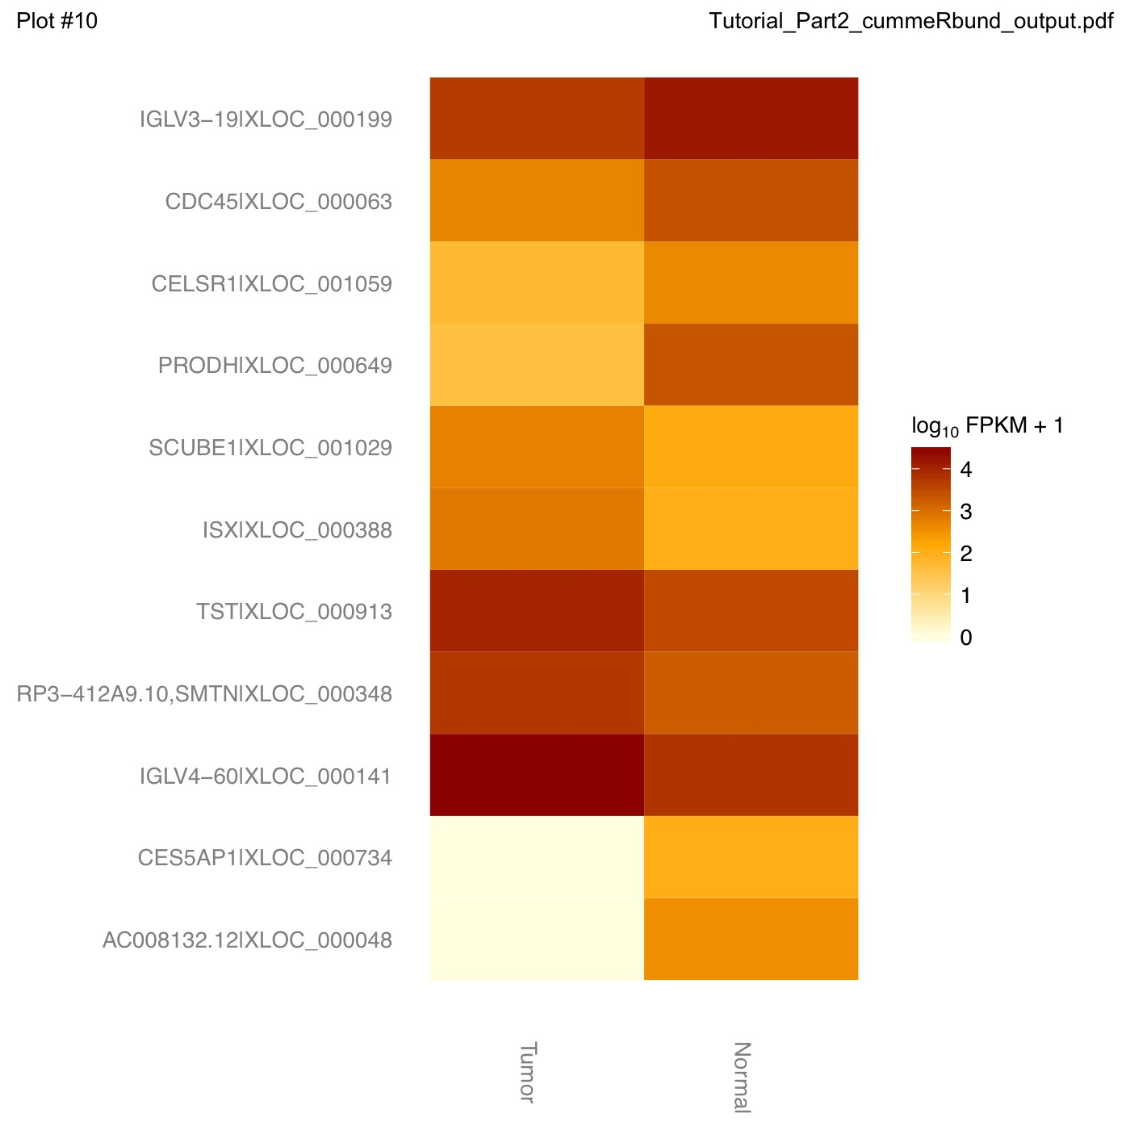
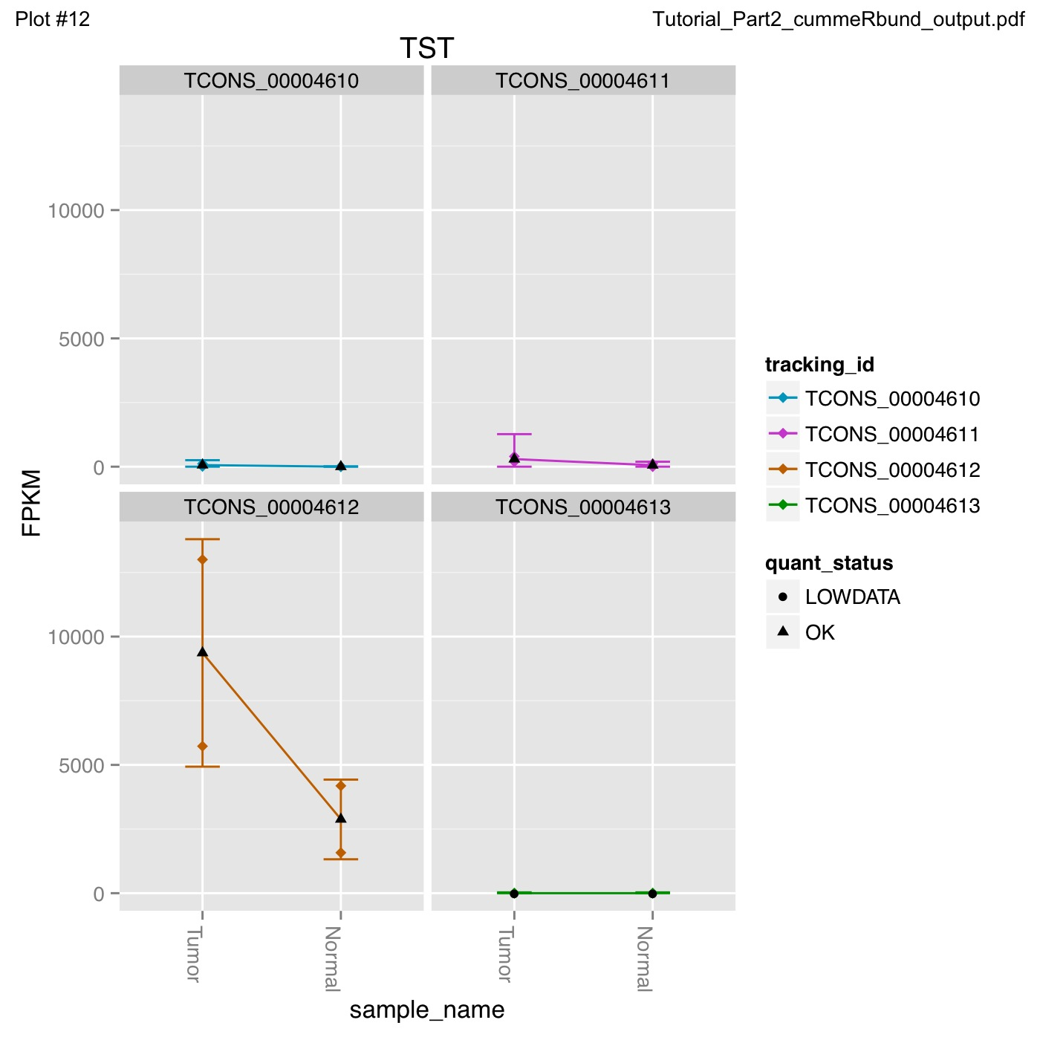
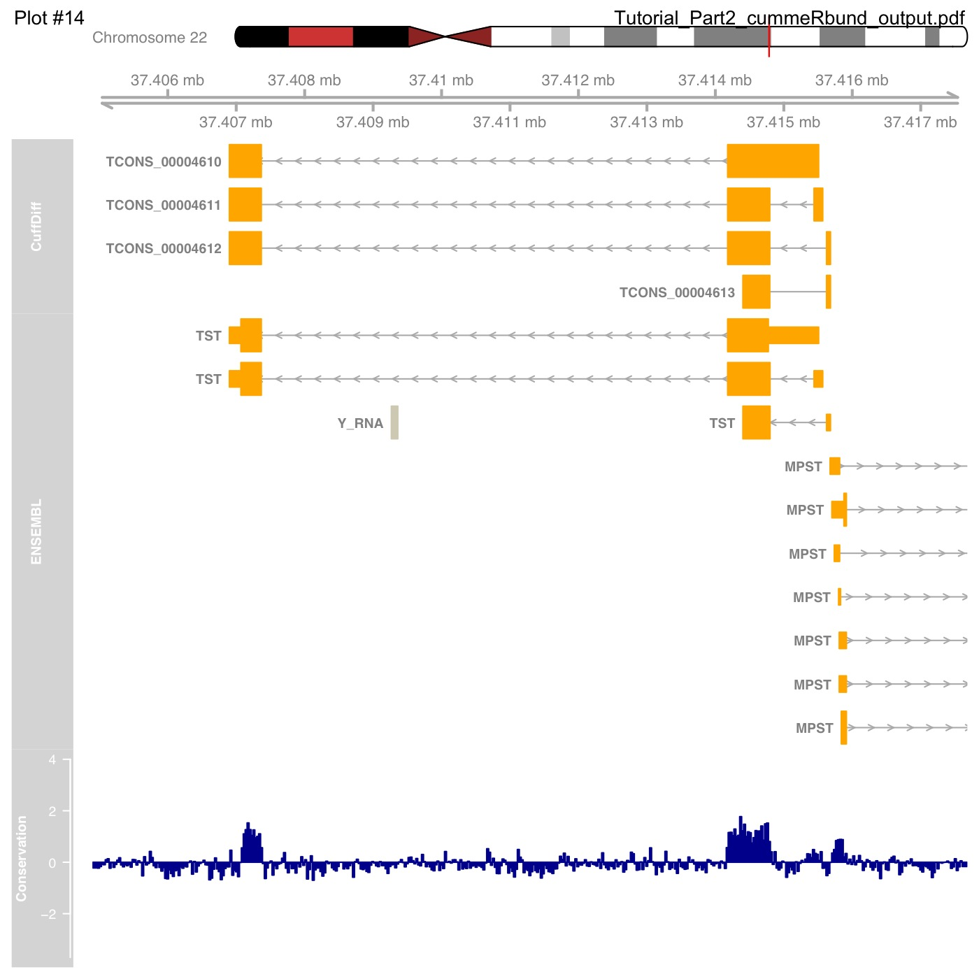
cummeRbund
Analysis of expression in R
Notes:
Once you’ve generated the expression values, then its necessary to visualise them and create summary and even individual gene plots. This is best done in interactive statistical packages like the R package cummeRbund, which can do a lot of heavy lifting for you, at the expense of you needing to know a little bit of R programming.
Cummerbund Automatically generates many of the commonly used data visualizations
Distribution plots
Overall correlations plots
MA plots
Volcano plots
Clustering, PCA and MDS plots to assess global relationships between conditions
Heatmaps
Gene trees

Slide 23
Which tool? Which experimental design?
False/True Positive Rate at different fold changes and replicate numbers
Fold Change Cutoff
0
0.5
2.0
Tool
Samples
Schurch et al
http://arxiv.org/pdf/1505.02017v2.pdf
Notes:
Ok so finally I want to mention the issue of replicates, This study of statistical power of differential expression detection looks at the true positive and false positive rate at different numbers of samples sequenced. So the rows are 3,6 12 and 20 samples sequenced and the columns are increasing fold change cutoffs applied.
And we can see from this that at the lower number of replicates the true positive rate is reduced by around ten percent for most tools studied, so you get a real reduction in power from doing the standard just 3 replicates. And it gets worse if you want to try and spot smaller differences in expression.

Slide 24
Which tool? Which experimental design?
At least six replicates per condition for all experiments.
At least 12 replicates per condition for experiments where identifying the majority of all DE genes is important.
For experiments with <12 replicates per condition; use edgeR(exact).
For experiments with >12 replicates per condition; useDESeq.
Apply a fold-change threshold appropriate to the number of replicates per condition between 0.1 ≤ T ≤ 0.5.
Schurch et al
http://arxiv.org/pdf/1505.02017v2.pdf
Notes:
And the paper is worth taking a close look at if you are designing the experiment since it makes some pretty strong recommendations about tool choice relative to experimental design, including stating you should use at least 6 replicates for all experiments.
Obviously this will in the real world be tempered by what funds are available but it is food for thought and if you do need to get close to the all differentially expressed genes then you absolutely do need more than the minimum three replicates.

Slide 25
No big red buttons in bioinformatics
Notes:
Ok,
So thats all I want to say about RNASeq. I just want to push the point again that you cant use these tools blindly and without appraisal at each step of the way and if you intend to make the most of sensitivity of the sequencing technology the analytical pipeline has to be properly powered to deal with the massive number of places this can go wrong so QC and good experimental design are key when it comes to getting the most from these experiments.

Slide 26
Acknowledgements
References and slides
https://github.com/danmaclean/mpmi_training

